Slide 1

Classification of Parkinson’s Disease using CNN and ANN with the aid of Drawing and Acoustic Feature
Syed Fiza
Ashish Kumar
Jatin Yadav
Sainandan Reddy
Tej Kurma Sidda
Kaarthik Sai

Slide 2
Outline of the Presentation :
INTRODUCTION
PROBLEM STATEMENT
DETAILS OF WORK
RESULTS
CONCLUSION
REFERENCES

Slide 3
Introduction:
Parkinson's disease manifests itself in a variety of ways. slurred speech, muscle rigidity, and tremors. The condition can also affect the production of the brain's dopamine. Therapies can help treat conditions after a diagnosis, however, there is no remedy. The paper primarily analyses the many drawing evaluation methods and disease diagnoses that have been used. The AI deep learning idea was used, along with convolutional neural networks and artificial neural networks.
This article proposes a model for detecting disease using drawings of different persons from two classes. Disease detection on photos has been accomplished using a variety of techniques such as data augmentation, sequential, and CNN. The acoustic feature data was processed using a Decision tree and ANN with GridsearchCV, and the overall accuracy on testing data was 98 percent.

Slide 4
Problem Statement
The purpose of this work is provide an effective system which can help detect Parkinson’s Disease.
The Utilised dataset contains 72 training and 30 testing images.
Based on the extracted features from the proposed method and classify the Parkinson’s Disease accurately.

Slide 5
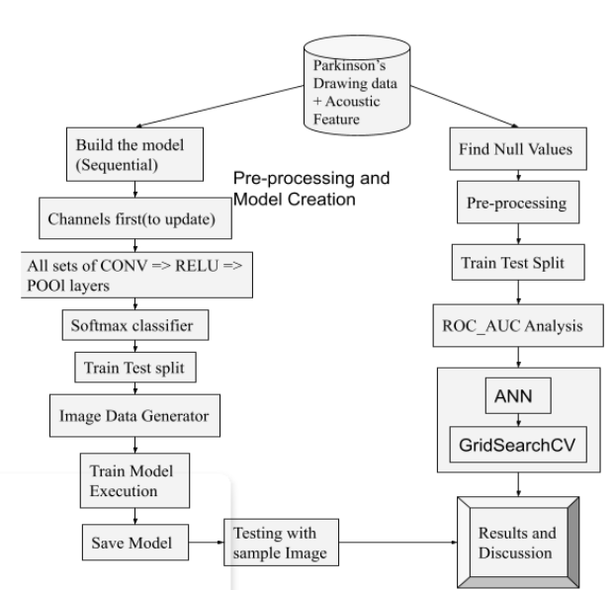
Block Diagram

Slide 6
Process
First, the data is pre-processed before it is trained and tested. Pre-processing is divided into four steps. To begin, use sequential to initialize the model and 'channels first' to update the input shape.
The first set of CONV to RELU to POOL [19] layers has been added, but the second set is about to be added. Following that, a new set of layers employing FC => RELU is created.
The activation of the softmax classifier[23] in order to include it in the model execution. The spiral and wave data divisions were utilized twice to assess the fruit fullness of the data presented.
In addition, the number of epochs to train, starting learning rate, and batch size are also set. The data and labels were added in order to load the photographs from the path we specified.
The data was gathered by random shuffling techniques. Once the path generating was set, the extraction of the class label in front of the given picture path and updating the labels list took place. The raw intensities scale runs from 0 to 1.
The train test separates the data 75 percent for training and 25 percent for testing.

Slide 7
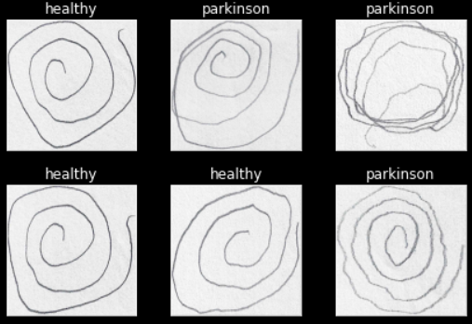
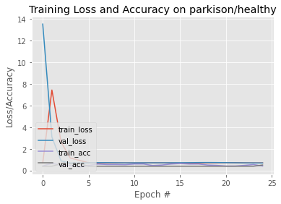
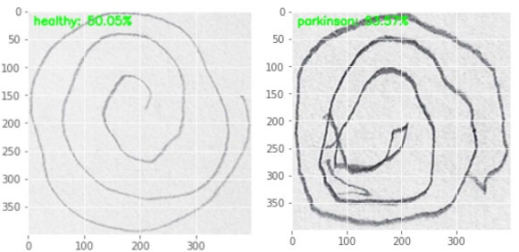
Result’s
PD Spiral Drawing Testing performance

Slide 8
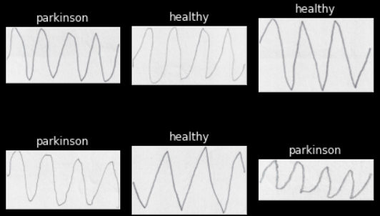
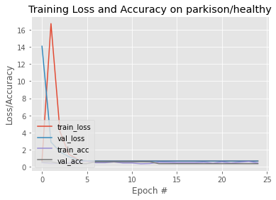
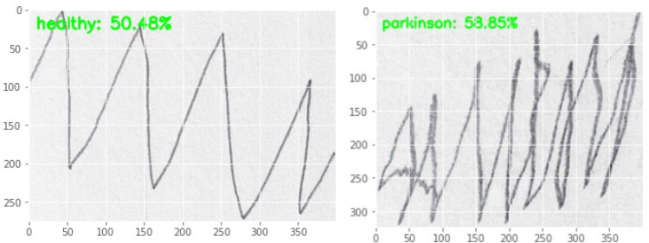
PD Wave Drawing Testing performance

Slide 9
Conclusion
This work helps us to understand the probable deteriorating conditions of a person having Parkinson’s Disease.
The best possible approach is a clever combination of the optimization technique concept with CNN and ANN with GridsearchCV. Researchers in this field might be interested in developing such technologies. Our model performed with better accuracy on testing photos. Further, our method is fairly robust and efficient in terms of memory storage.

Slide 10
References:
[1] C. Blauwendraat, M. A. Nalls, and A. B. Singleton, "The genetic architecture of Parkinson's disease," The Lancet Neurology, vol. 19, pp. 170-178, 2020.
[2] A. E. Lang and A. M. Lozano, "Parkinson's disease," New England Journal of Medicine, vol. 339, pp. 1130-1143, 1998.
[3] L. M. De Lau and M. M. Breteler, "Epidemiology of Parkinson's disease," The Lancet Neurology, vol. 5, pp. 525-535, 2006
[4] J. Goyal, P. Khandnor, and T. C. Aseri, "A Comparative Analysis of Machine Learning classifiers for Dysphonia-based classification of Parkinson’s Disease," International Journal of Data Science and Analytics, vol. 11, pp. 69-83, 2021/01/01 2021.
[5] O. Bchir, "Parkinson’s Disease Classification using Gaussian Mixture Models with Relevance Feature Weights on Vocal Feature Sets," International Journal of Advanced Computer Science and Applications, vol. 11, 2020.

Slide 11
[6] C. Wang, C. Deng, and S. Wang, "Imbalance-XGBoost: leveraging weighted and focal losses for binary label-imbalanced classification with XGBoost," Pattern Recognition Letters, vol. 136, pp. 190-197, 2020/08/01/ 2020.
[7] I. Nissar, D. Rizvi, S. Masood, and A. Mir, "Voice-Based Detection of Parkinson’s Disease through Ensemble Machine Learning Approach: A Performance Study," EAI Endorsed Transactions on Pervasive Health and Technology, vol. 5, 2019.
[8] K. Polat, "A Hybrid Approach to Parkinson Disease Classification Using Speech Signal: The Combination of SMOTE and Random Forests," in 2019 Scientific Meeting on Electrical-Electronics & Biomedical Engineering and Computer Science (EBBT), 2019, pp. 1-3.
[9] D. Schellhas, B. Neupane, D. Thammineni, B. Kanumuri, and R. C. Green II, "Distance Correlation Sure Independence Screening for Accelerated Feature Selection in Parkinson's Disease Vocal Data," arXiv preprint arXiv:2006.12919, 2020.
[10] Ş. Yücelbaş, "Simple logistic hybrid system based on greedy stepwise algorithm for feature analysis to diagnose Parkinson’s disease according to gender," Arabian Journal for Science and Engineering, vol. 45, pp. 2001-2016, 2020.

Slide 12
Thanks!

